Slide 1

An Intro to Python for Radiologists
(with a bit of informatics as well)
Oliver Nickalls, Consultant, SKH
oliver.james.nickalls@singhealth.com.sg
Notes:
Whizz through some slides and get onto the jupyter notebook stuff.

Slide 2
The [old] Plan
What is Python?
Why Python?
Mini Radiology Informatics ‘refresher’
Mini Python projects
DICOM Anonymiser
DICOM handling, editing, OCR, image manipulation
MRI defacing (using AI)
AI with Tensorflow
Train a simple image classifier

Slide 3
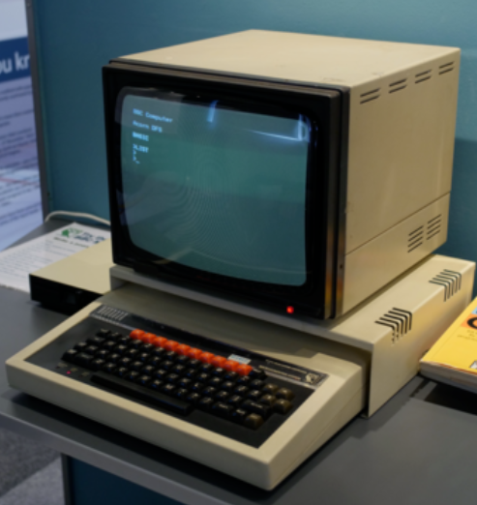
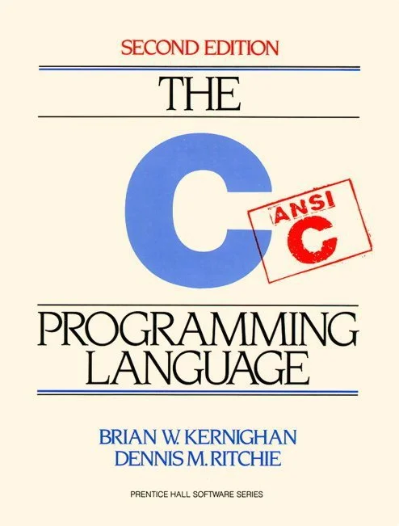
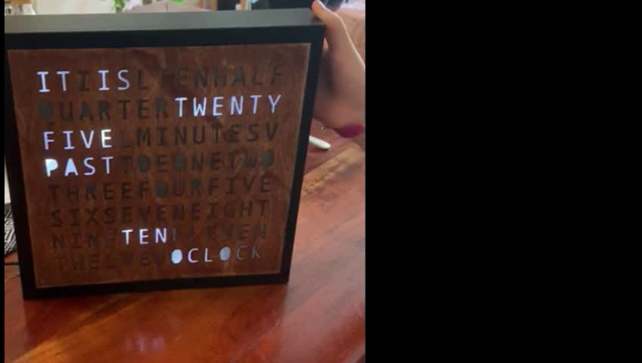
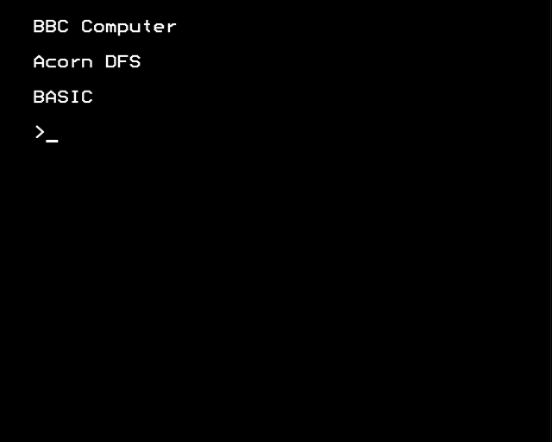
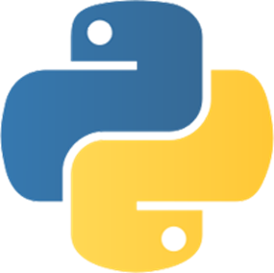
How I got Started…
BBC Micro
QuickBasic
VisualBasic
‘C’ in 2000
BSc Thesis: cone-beam CT reconstruction
Python from 2018
(Also some ‘C++’ for microcontroller projects)

Slide 4
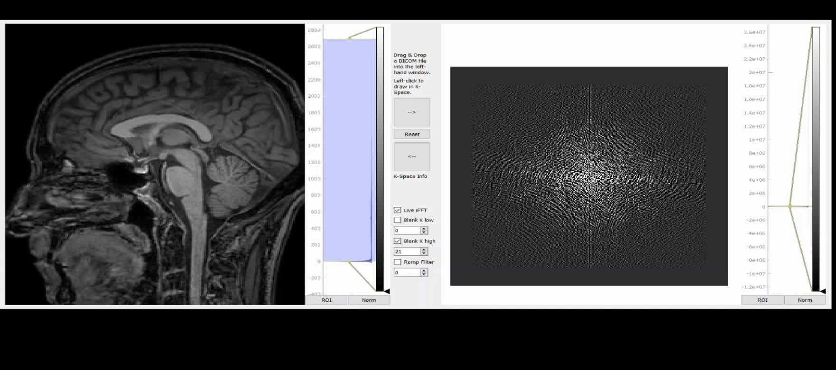
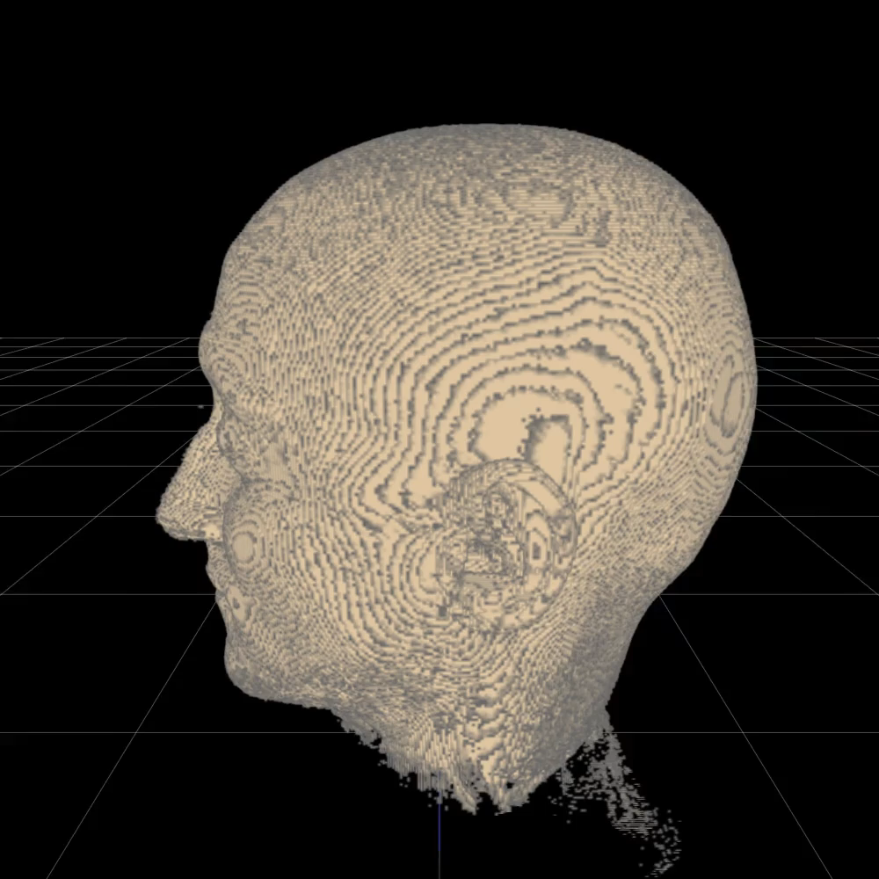
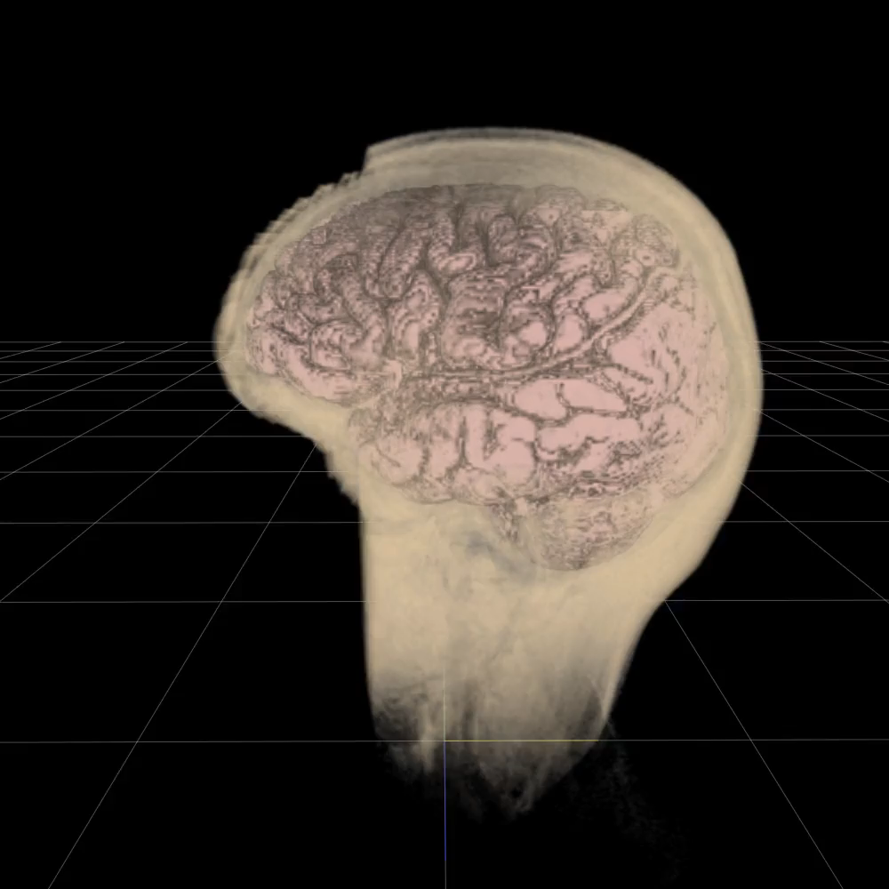
Some Past Python Projects
K-Space Visualiser
T1w Brain
Defacer

Slide 5
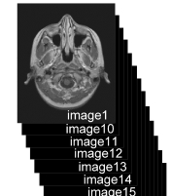
Current Projects
Train AI to Deface MRI brain datasets (directly)
My previous solution:
T1 volume
→ generate brain mask
→ add to the mask to include face voxels
→ Apply mask to original volume - keep only the non-face voxels
Notes:
The issue is the data preparation…

Slide 6

Projects in Jupyter…

Slide 7

Python is easy. And Powerful.

Slide 8
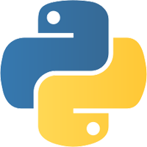
Recap:
Python - The what and the why
DICOM - and the DICOM file content
Jupyter Projects:
DICOM - exploration, anonymisation, editing, image text removal
MRI defacing - the Lego approach to Python
AI ‘Frog-or-Not’ - Training a simple classification AI model

Slide 9


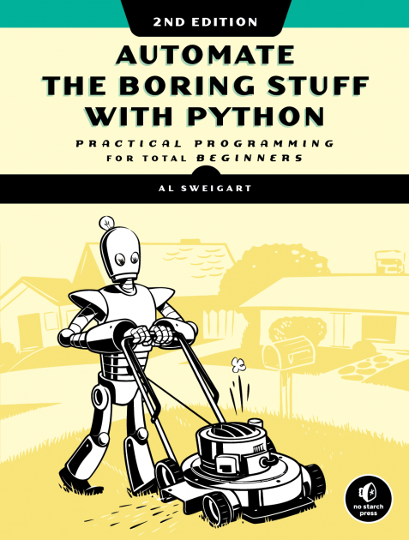
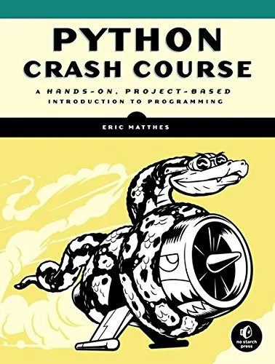



If you are interested…
Python can be installed by IHIS on Singhealth computers (Anaconda)
How to install Python (Win/Mac/Linux):
https://realpython.com/installing-python/
Learn by doing
online courses and tutorials
think of small projects and work up.
Go for the easy wins!
MOOCs:
Websites:
Books:
oliver.james.nickalls@singhealth.com.sg

